Slide 1
Test/Control – Module 2 Propensity Score Matching

Slide 2
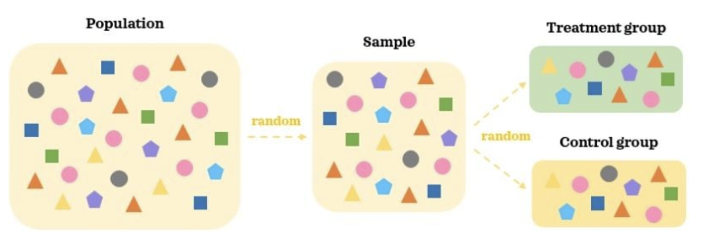
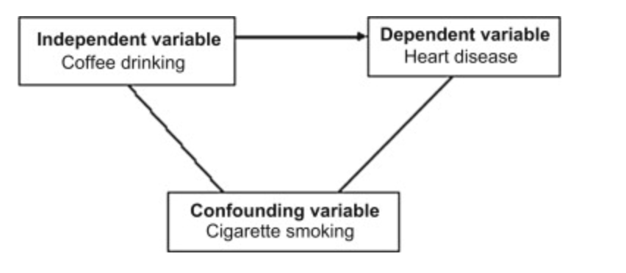
Propensity Score Matching – Key Terms
Confounders :
A confounding variable (confounder) is a factor other than the one being studied that is associated both with the disease (dependent variable) and with the factor being studied (independent variable).
For example, a hypothesis that coffee drinkers have more heart disease than non-coffee drinkers may be influenced by another factor. Coffee drinkers may smoke more cigarettes than non-coffee drinkers, so smoking is a confounding variable in the study of the association between coffee drinking and heart disease. The increase in heart disease may be due to the smoking and not the coffee.
The treatment group (also called the experimental group) receives the treatment whose effect the researcher is interested in.
The control group receives either no treatment, a standard treatment whose effect is already known, or a placebo (a fake treatment to control for placebo effect).
https://builtin.com/data-science/propensity-score-matching

Slide 3
Propensity Score Matching
A propensity score in healthcare is a single numerical value that indicates the probability a patient will need specific treatment based on baseline characteristics. It is the probability of each individual being assigned to the treatment group.
Propensity score matching involves forming matched sets of treated and untreated subjects who have similar propensity scores.
Typically, they are matched one-to-one. Once a match is made, the impact of treatment can be estimated by comparing the health outcomes between the treated and untreated patients.
Propensity scores are generally estimated using a multivariable logistic regression model, where treatment status is regressed against potential confounders. The model can incorporate a large number of background covariates to estimate a single number of propensity scores, ranging from 0 to 1 for each patient.
Propensity scores are an alternative method to estimate the effect of receiving treatment when random assignment of treatments to subjects is not feasible.
Propensity score matching (PSM) refers to the pairing of treatment and control units with similar values on the propensity score, and possibly other covariates, and the discarding of all unmatched units.
It is primarily used to compare two groups of subjects but can be applied to analyses of more than two groups.
History of PSM
The concept of PSM was first introduced by Rosenbaum and Rubin (1983) in a paper entitled “The Central Role of the Propensity Score in Observational Studies for Casual Effects.”
http://mchp-appserv.cpe.umanitoba.ca/concept/propensity_score_matching.pdf

Slide 4


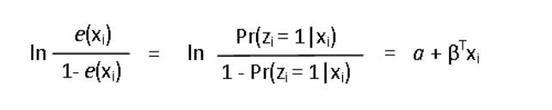
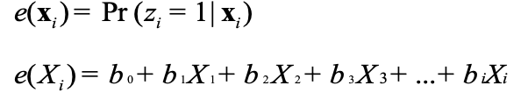
Propensity Score Matching
Statistical Definition
General Method for Calculating Propensity Scores
Propensity scores are generally calculated using one of two methods:
Logistic regression or
Classification and Regression Tree Analysis (CART).
The estimated propensity score e(xi ) , for subject i,( i = 1,…, N ) is the conditional probability of being assigned to a particular treatment given a vector of observed covariates xi
Logistic regression:
This is the most commonly used method for estimating propensity scores. It is a model used to predict the probability that an event occurs.
and
where:
b0 : intercept,
bi : Regression coefficient
Xi : Treatment variables and covariates
xi : Observed value of variables
where:
zi = 1, for treatment
zi = 0, for control and
xi , the vector of observed covariates for the ith subject
Since the propensity score is a probability, it ranges in value from 0 to 1.
In logistic regression, the dependent variable is binary,
Zi=1 is the value for the treatment
Zi=0 is the value for the control
Classification and Regression tree analysis (CART):
This is a non-parametric decision tree method that can efficiently partition populations into homogenous subgroups (Lemon, Freidmann, Rakowski, 2003).
It is not as widely used as logistic regression for estimating propensity scores because it is complex and more suitable for use by those with a statistical background.
http://mchp-appserv.cpe.umanitoba.ca/concept/propensity_score_matching.pdf

Slide 5
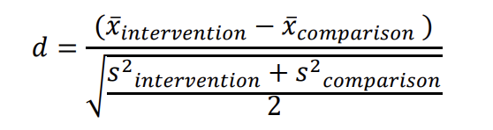

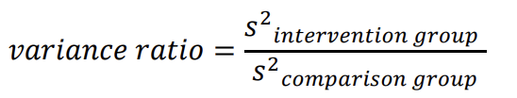
Propensity Score Matching – Implementation
Below are the steps involved in the propensity score matching process
Step 1: Select Covariates
Step 5: Comparing Balance
The first step of using propensity score matching is to select the variables (aka “covariates”) to be used in the model. Ideally, propensity scores are created from covariates related to participants’ self-selection into an intervention.
When propensity scores are created via logistic regression, the covariates serve as the predictors of participation in the intervention (0/1).
Once the matches are created, it is important to assess the quality of the matches in order to ensure the comparison group has a distribution of propensity scores similar to the intervention group. Below are few methods for comparison
T-test : Null hypothesis significance testing (NHST) analyses (e.g., t-tests) are commonly used to compare the distribution of covariates and propensity scores
Cohen’s d statistics : comparing the standardized difference of group propensity score means.
Variance Ratio : Ratio of variances between participants (intervention/treatment group) and nonparticipants (comparison/control group) on the propensity score and on each individual covariate. The variance ratio should be close to one
Step 2: Select Model for Creating Propensity Scores
Respective group mean
Propensity scores may be calculated using various techniques (e.g., logistic regression, CART, mahalanobis distance, etc.) to create a multivariate composite of the covariates.
It is important to note that the method (e.g., logistic regression) is not employed for inferential purposes, but simply for the purpose of creating a balancing score – a propensity score.
When creating propensity scores via logistic regression, the researcher is simply computing the probability that the person received the intervention (0/1), given the set of covariates included in the model.
Respective group Variance
Steps 3 & 4: Select a Matching Method and Create Matches
Step 6: Estimating the Effects of an Intervention
Once propensity scores are computed, a common approach is to create balanced intervention and comparison groups – either using one-to-one or one-to many matching.
There are numerous approaches for creating a comparison group, some of which include exact matching, nearest neighbor (NN) matching with or without caliper adjustment, and optimal matching
The most commonly-used approaches to creating matches from propensity scores are NN and NN with caliper adjustment
After a comparison group is created using propensity score matching techniques, the effect of the intervention can be estimated.
If the goal is to estimate treatment effects for only the individuals who participated in the intervention, then the average treatment effect on the treated (ATT) can be easily estimated
Alternatively, the goal might be to make inferences regarding the effects of an intervention as it would generalize to the overall population, regardless of whether they received treatment. In this situation, the average treatment effect (ATE) is estimated.
http://mchp-appserv.cpe.umanitoba.ca/concept/propensity_score_matching.pdf

Slide 6
Applications and Experiences in our domain
The logistic regression model R-Square is an important factor. Apply this matching method only when the R-Sqares of propensity score prediction is quite high – say > 0.8
Multiple applications (Speaker Programs etc) of propensity scoring models produced very low R-square. Suggesting that the chosen Test candidates are closer to random under the covariates studied. HENCE, APPLICATION OF PRPENSITY SCORES IS NOT RECOMMENDED OR VALID IN SUCH SITUATIONS.
Due to the predictive accuracy issues, these models were not widely adopted in our domain.

